Slide 1
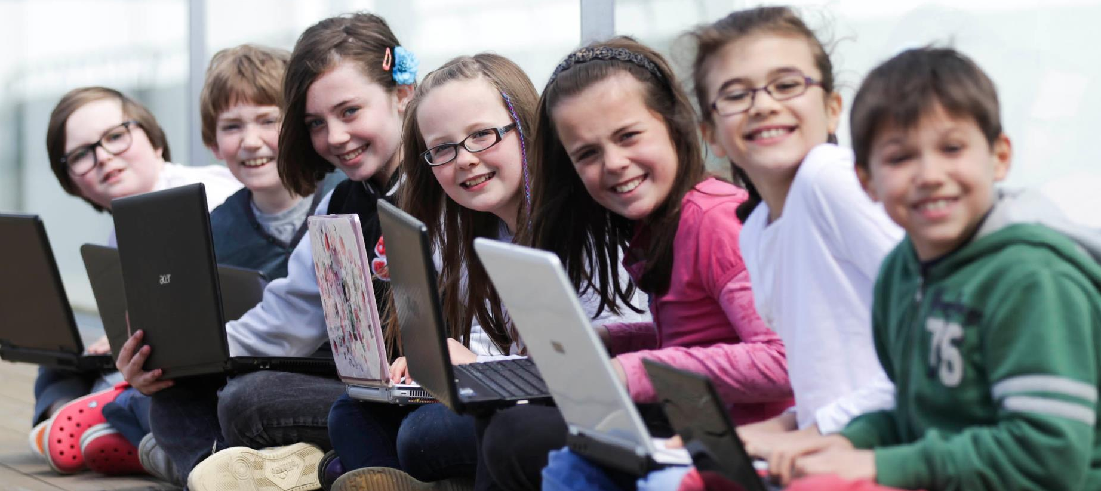

Giving kids and young people all over the world better access to the Magic behind the technology that surrounds us and touches almost everything that we do in our lives, CoderDojo is a global community of free programming clubs for young people.

Slide 2
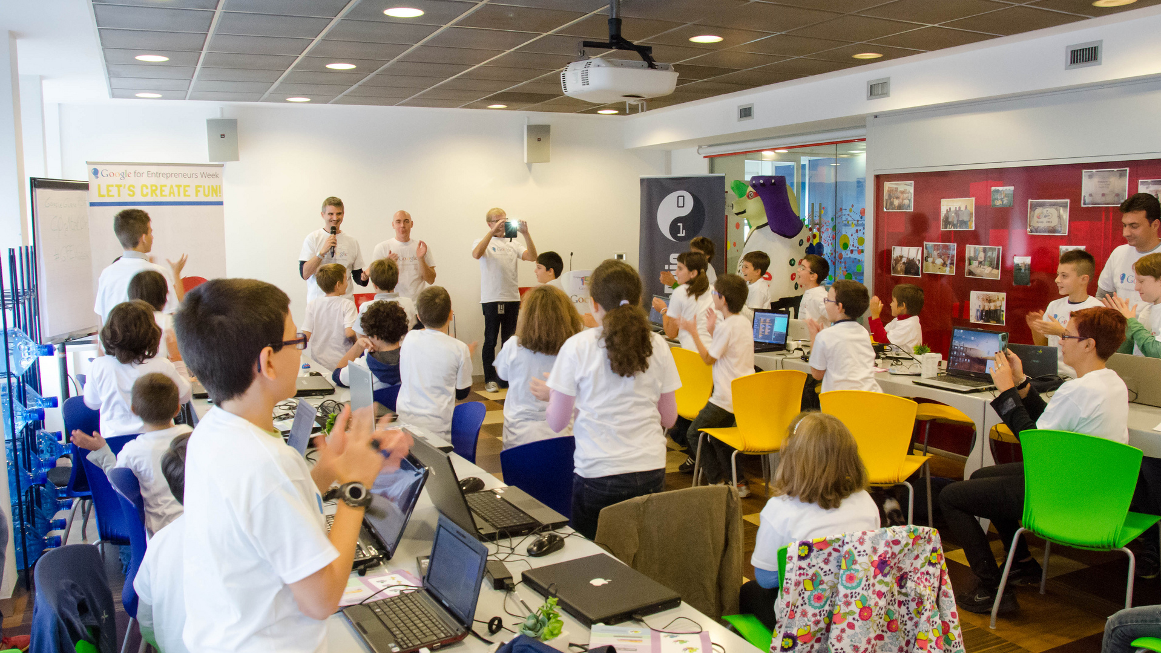
What is CoderDojo
CoderDojo is a global volunteer-led community of free programming clubs for young people between 7 and 17. Founded in July 2011 by James Whelton & Bill Liao, the first Dojo took place in Cork, Ireland on the 23rd of July. James and Bill were self taught programmers and wanted to create a space where young people could learn code in a social environment.
Within CoderDojo there is a focus on developing creativity, a sense of community, peer learning skills, mentoring and self led learning with an emphasis on openness and showing how coding can be a force for positive change.
For a video about CoderDojo click here.

Slide 3

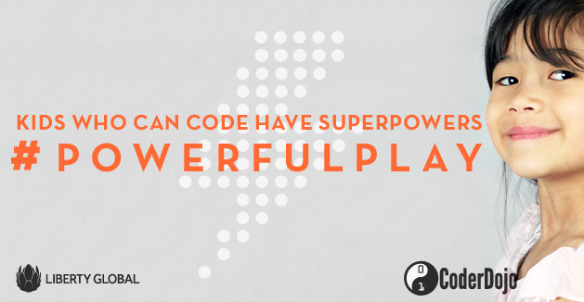
The CoderDojo #powerfulplay campaign
This campaign centers around the playful notion that “Kids who can code have superpowers”. This tagline emphasizes that learning to code is an important powerful skill for the future of next generation of digital creators.
#powerfulplay

Slide 4
What is the aim of the #powerfulplay campaign
What is CoderDojos biggest challenge?
It is hard to find Mentors and Volunteers (both technical and non-technical) to start CoderDojos.
Why are we promoting a social media campaign for CoderDojo Champions?
CoderDojo is looking to rapidly expand the number of coding clubs across the world to reach more young people, giving them the opportunity to learn coding in a fun and social enviornment to become the next generation of digital creators!
4

Slide 5
How can you help?
Spread the word:
We are asking for your help to spread the word about CoderDojo amongst your network with the aim to source new Champions that will start CoderDojos in their area.
How can I do this?
Choose on of the images and promote it amongst your network.
Social Media
Posting the images via your Social media accounts.
Community Mails / Newsletter
Add the images to your community newsletter or send out a mail to your community / business mailing lists.
5

Slide 6
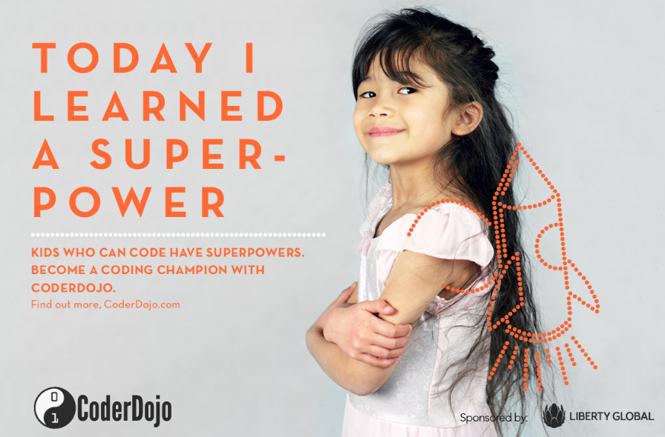
Image 1 – Become a Coding Champion
Target audience | Social Media platform | Suggested social media message | Link to landing page
General Public - Adults | For use on any social media platform. Twitter Facebook G+ LinkedIn | 1. Do you want to create a space for young people to learn code in a fun and social environment? How about starting a CoderDojo? 2. You don’t have to be a digital whizz to be a CoderDojo Champion and inspire the next generation of digital creators at CoderDojo. 3. A CoderDojo Champion is a volunteer who starts a CoderDojo to facilitate young people to learn how to code. Become a Champion by starting a CoderDojo today! Hashtags: #powerfulplay #CoderDojo #codeEU #eskills | http://bit.ly/1yAaOIZ

Slide 7

Notes:
EDITABLE COPIES OF DIFFERENT LANGUAGES
Please always include #powerfulplay on all images.
Fonts used: Avenir, NeutratextTF
Suggested Messaging:
Today I learned a super power!
Kids Who Code have super powers, start a local coding club and become a CoderDojo Champion. #powerfulplay
Social Media Post Messaging:
1. Do you want to create a space for young people to learn code in a fun and social environment? How about starting a CoderDojo?
2. You don’t have to be a digital whizz to be a CoderDojo Champion and inspire the next generation of digital creators at CoderDojo.
3. A CoderDojo Champion is a volunteer who starts a CoderDojo to facilitate young people to learn how to code. Become a Champion by starting a CoderDojo today!

Slide 8
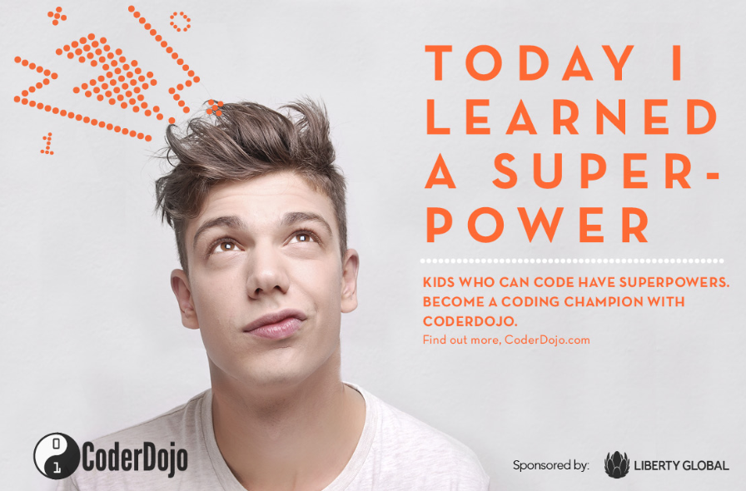
Image 2 – Become a Coding Champion
Target audience | Social Media platform | Suggested social media lead line | Link to landing page
General Public - Adults | For use on any social media platform. Twitter Facebook G+ LinkedIn | 1. You don’t need coding skills to help young people gain coding superpowers! Volunteer and support your local CoderDojo today! 2. A CoderDojo Champion is a volunteer who starts CoderDojo to facilitate young people to learn how to code. Become a Champion Start your CoderDojo today! 3. Love code? Inspire the next generation of digital creators by becoming a CoderDojo Champion and starting your own CoderDojo. Hashtags: #powerfulplay #CoderDojo #codeEU #eskills | http://bit.ly/1xF8A9D

Slide 9
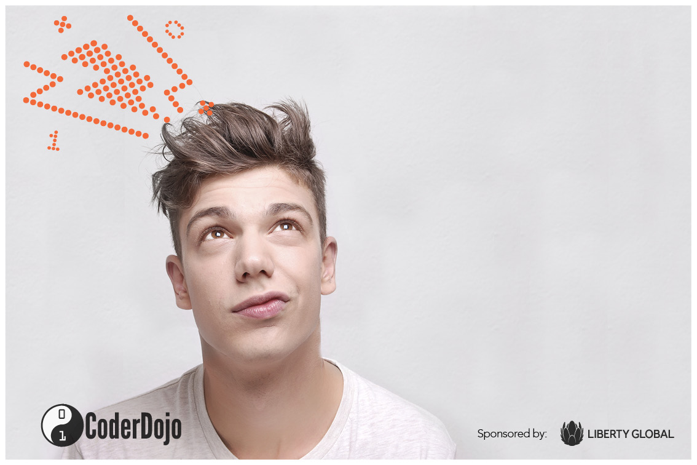
Notes:
EDITABLE COPIES OF DIFFERENT LANGUAGES
Please always include #powerfulplay on all images
Fonts used: Avenir, NeutratextTF
Suggested Messaging:
Today I learned a super power!
Kids Who Code have super powers, start a local coding club and become a CoderDojo Champion. #powerfulplay
Social Media Post Messaging:
1. You don’t need coding skills to help young people gain coding superpowers! Volunteer and support your local CoderDojo today!
2. A CoderDojo Champion is a volunteer who starts CoderDojo to facilitate young people to learn how to code. Become a Champion Start your CoderDojo today!
3. Love code? Inspire the next generation of digital creators by becoming a CoderDojo Champion and starting your own CoderDojo.

Slide 10
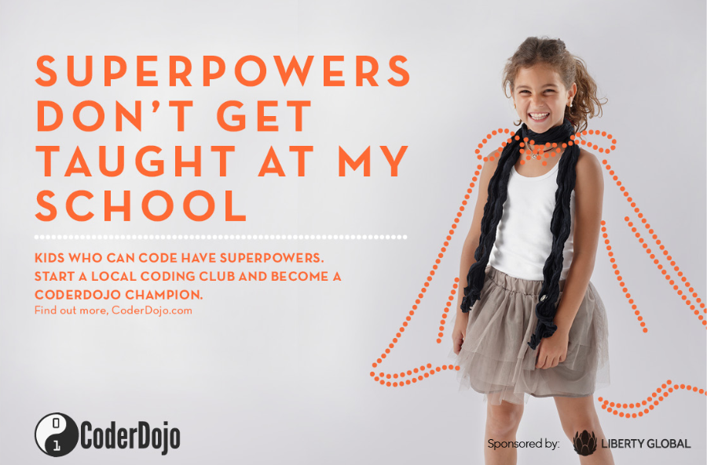
Image 3 – Promoting CoderDojo after school clubs
Target audience | Social Media platform | Suggested social media lead line | Link to landing page
Parents | For use on any social media platform. Twitter Facebook G+ LinkedIn | 1. Start your own CoderDojo coding club and give young people in your area access to new coding superpowers and see them create something truly awesome! 2. Did you know your child can learn to code in a fun and social after school environment? Look up your local CoderDojo to find out more! 3. Digital Superheroes WANTED! Start a CoderDojo coding club and help young people develop the coding superpowers to become the next generation of Digital Superheroes. Hashtags: #powerfulplay #CoderDojo #codeEU #eskills | http://bit.ly/1pHYegt

Slide 11
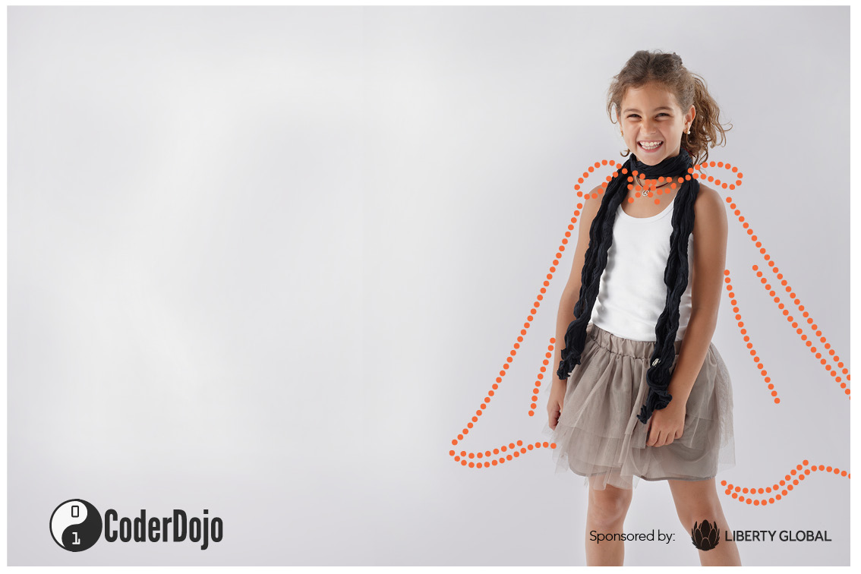
Notes:
EDITABLE COPIES OF DIFFERENT LANGUAGES
Please always include #powerfulplay on all images
Fonts used: Avenir, NeutratextTF
Suggested Messaging:
Super powers don’t get taught at my School.
Kids Who Code have super powers, start a local coding club and become a CoderDojo Champion. #powerfulplay
Social Media Post Messaging:
1. Start your own CoderDojo coding club and give young people in your area access to new coding superpowers and see them create something truly awesome!
2. Did you know your child can learn to code in a fun and social after school environment? Look up your local CoderDojo to find out more!
3. Digital Superheroes WANTED! Start a CoderDojo coding club and help young people develop the coding superpowers to become the next generation of Digital Superheroes.

Slide 12
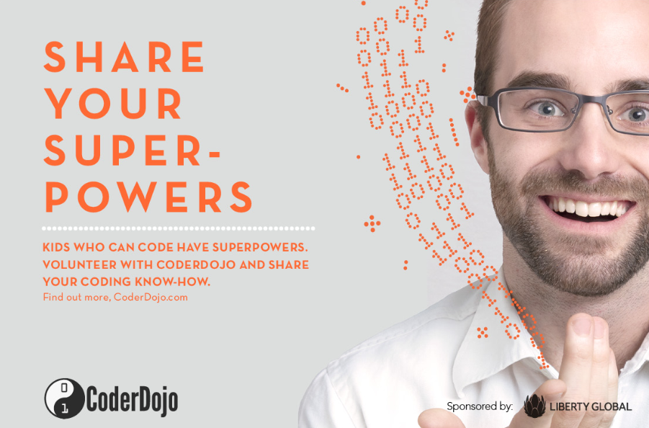
Image 4 - People in technology / Programmers
Target audience | Social Media Platforms | Suggested social media lead line | Link to landing page
People with coding skills. | Coding sites for coding professionals. Identify a few sites in your market and ask if they will promote the campaign | 1. Can you code? Share your coding knowledge and inspire the next generation of young coders at your local CoderDojo! 2. Love coding? Make a difference and inspire young people to code at your local CoderDojo! 3. Do you know how to code? How about Mentoring the next gneration of digital creators at your local CoderDojo coding club. Hashtags: #powerfulplay #CoderDojo #codeEU #eskills | http://bit.ly/1psIMW8

Slide 13

Notes:
EDITABLE COPIES OF DIFFERENT LANGUAGES
Please always include #powerfulplay on all images
Fonts used: Avenir, NeutratextTF
Suggested Messaging:
Share your super powers at CoderDojo!
Kids Who Code have super powers, start a local coding club and become a CoderDojo Champion. #powerfulplay
Social Media Post Messaging:
1. Can you code? Share your coding knowledge and inspire the next generation of young coders at your local CoderDojo!
2. Love coding? Make a difference and inspire young people to code at your local CoderDojo!
3. Do you know how to code? How about Mentoring the next gneration of digital creators at your local CoderDojo coding club.

Slide 14
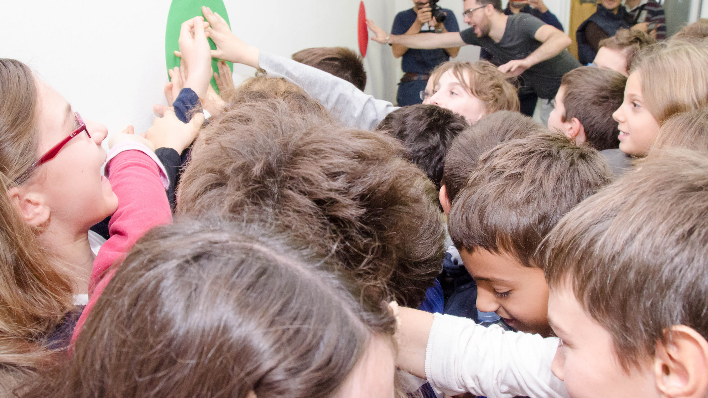
Thank you for your support!
14

